Slide 1




bnbbbbbbbbb
NEXT GEN EMPLOYABILITY PROGRAM
Creating a future-ready workforce
Team Members
College Name
Student Name :VINUSHA.V
Student ID :au511321205048
KINGSTON ENGINEERING COLLEGE-(5113)

Slide 2

CAPSTONE PROJECT SHOWCASE
Project Title
Building Bus Reservation System using Python and Django
Abstract | Problem Statement | Project Overview | Proposed Solution | Technology Used | Modelling & Results | Conclusion

Slide 3
Abstract
A comprehensive bus reservation system empowers travelers with the convenience of planning their journeys, selecting seats, and managing bookings through a user-friendly digital platform. This system streamlines the transportation experience, catering to the evolving needs of modern commuters.
The Bus Reservation System is a comprehensive software solution designed to streamline the process of booking and managing bus tickets for passengers and operators. In an increasingly digitized world, this system provides an efficient and user-friendly platform for passengers to book their bus tickets online, as well as for bus operators to manage their fleet and schedules seamlessly. The system offers a range of features tailored to meet the needs of both passengers and operators.
For passengers, it provides an intuitive interface where they can search for available buses, view schedules, select seats, make payments securely, and receive e-tickets instantly. Additionally, passengers can manage their bookings, make cancellations, and view their booking history conveniently through the system. The Bus Reservation System aims to enhance the overall travel experience for passengers while improving efficiency and profitability for bus operators.
Source :

Slide 4
Problem Statement
Issue: The current bus ticket booking process is cumbersome and inefficient, leading to dissatisfaction among passengers and operational challenges for bus operators. Challenges: Inconvenient booking process: Long queues and reliance on third-party agents. Limited information accessibility: Lack of real-time information on schedules, routes, and seat availability. Booking management complexity: Difficulty in managing bookings, changes, and cancellations. Operational inefficiencies: Manual processes leading to resource wastage and revenue loss for bus operators.
Inefficient Manual Processes
Existing bus reservation systems often rely on outdated manual processes, leading to errors, delays, and frustration for both customers and operators.
Limited Accessibility
Travelers face challenges in accessing bus schedules, availability, and booking options, particularly for long-distance routes.
Lack of Transparency
Customers often lack visibility into real-time bus status updates, seat availability, and the overall booking experience.
Source :

Slide 5
Project Overview
The project aims to develop a Bus Reservation System using Python and Django, a popular web framework, to modernize and streamline the bus ticket booking process for passengers while providing efficient management tools for bus operators. The system will consist of two main components: a user-facing interface for passengers to search for buses, book tickets, and track their journeys, and a backend dashboard for bus operators to manage routes, schedules, reservations, and analyze perform.
Streamlined Booking
Provide a user-friendly platform for customers to search, select, and book bus tickets with ease.
Real-time Updates
Implement a system that delivers real-time updates on bus schedules, seat availability, and journey status.
Integrated Management
Develop a comprehensive solution for bus operators to manage routes, inventory, and customer interactions.
Source :

Slide 6
Proposed Solution
Customer-centric Design
Prioritize user experience with intuitive interfaces, seamless booking flows, and personalized recommendations.
Real-time Data Integration
Leverage cutting-edge technologies to provide accurate, up-to-date information on bus schedules and availability.
Comprehensive Management Tools
Empower bus operators with robust management features, including route planning, inventory control, and analytics.
Source :

Slide 7


Technology Used
Front-end
Back-end
Source :

Slide 8
Modelling & Results
Data-driven Insights
Leverage data analytics to generate valuable insights and optimize the bus reservation system.
Intelligent Algorithms
Implement advanced algorithms for efficient seat allocation, route optimization, and dynamic pricing.
User Validation
Conduct user testing and iterative improvements to ensure the system meets customer needs.
Source :

Slide 9
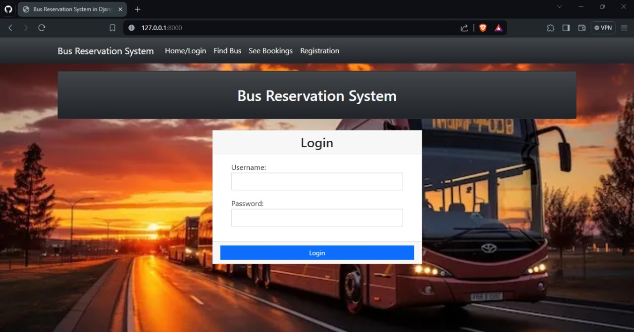
Homepage

Slide 10
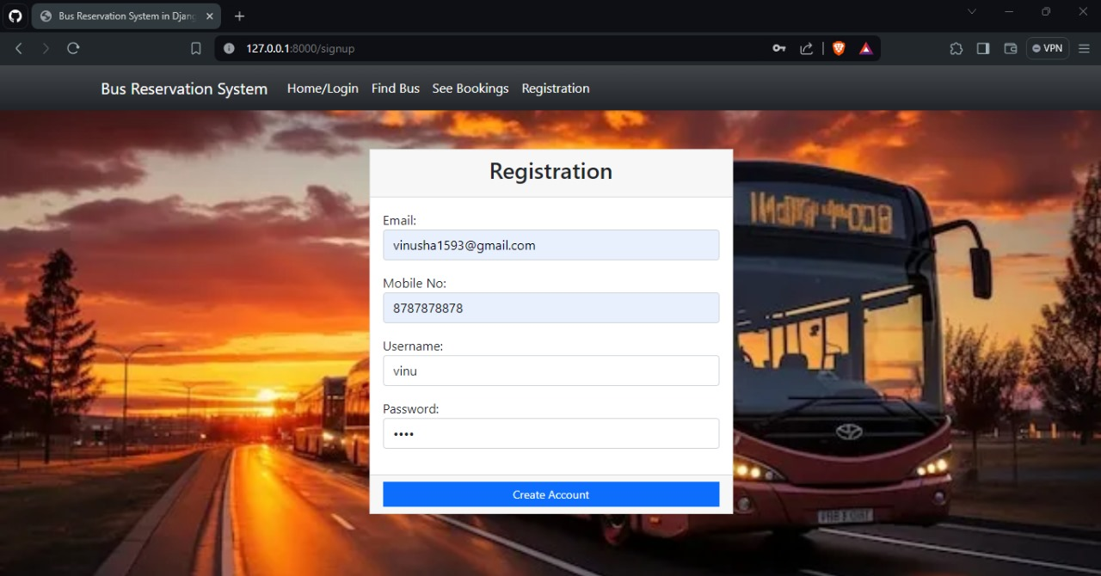
About-Us-Page

Slide 11
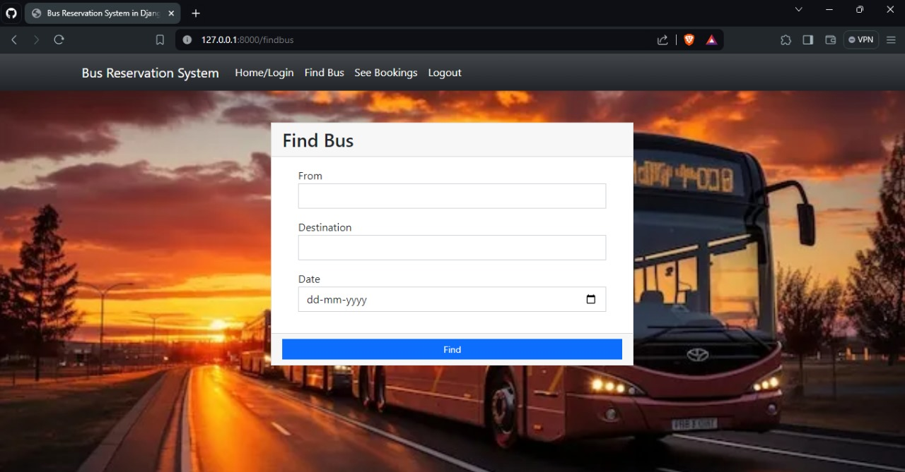
Service-Page

Slide 12
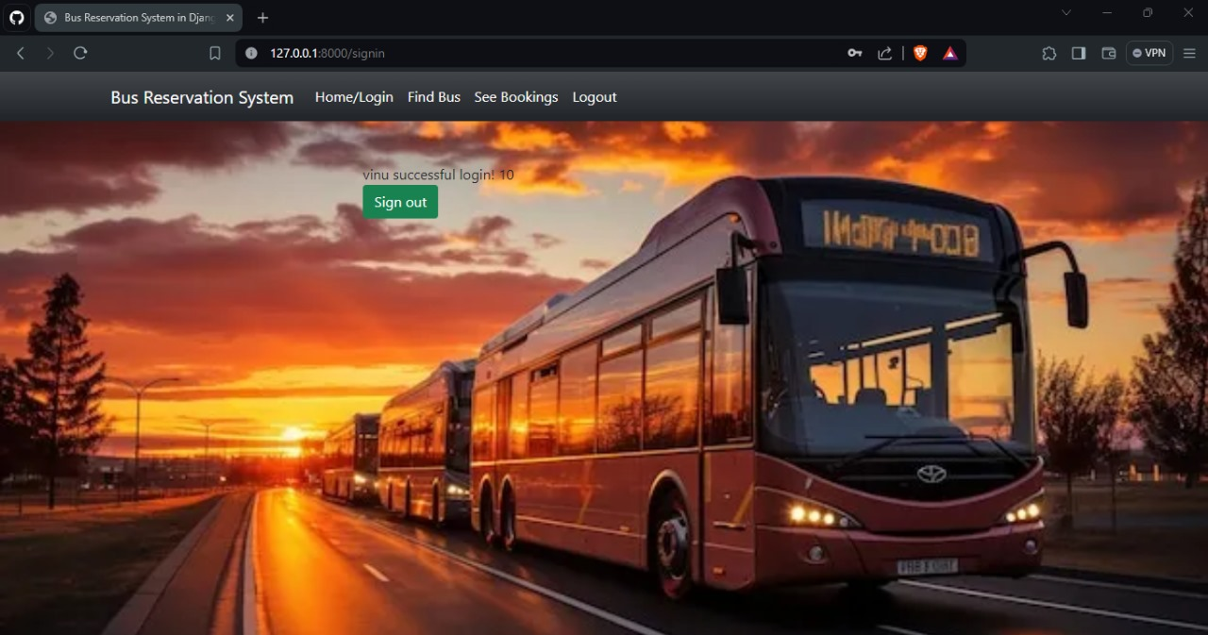
Departments-Page

Slide 13
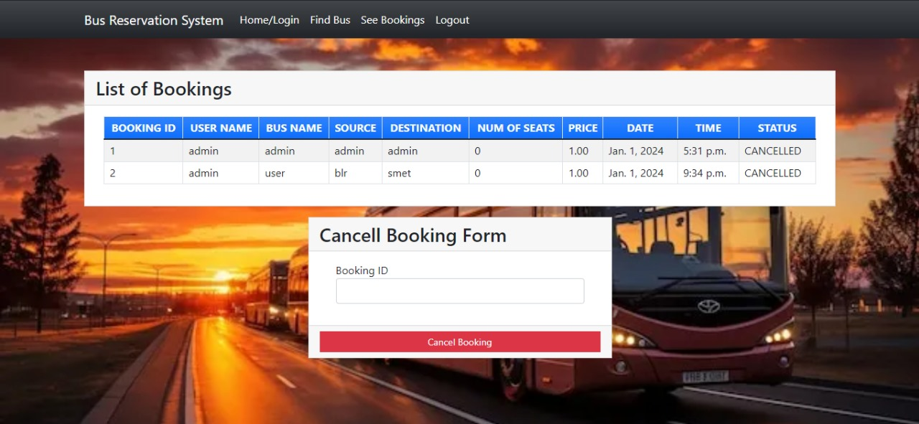
Blog-Page

Slide 14
Future Enhancements:
Mobile Integration
Develop a responsive mobile app for seamless on-the-go booking and management.
Multimodal Integration
Expand the system to include integration with other transportation modes, such as trains and airlines.
Predictive Analytics
Leverage machine learning to forecast demand patterns and optimize bus schedules and pricing.

Slide 15
Conclusion
Transformative Impact
The bus reservation system will revolutionize the transportation experience, empowering both customers and bus operators.
Sustainable Growth
The system's scalability and adaptability will support the evolving needs of the transportation industry.
Continuous Innovation
Regular updates and enhancements will ensure the system remains at the forefront of technology.
Source :

Slide 16
Thank You!
Notes:
Thank You !!

